Slide 1
CKAD Exam
Application Design and Build 20%
Application Deployment 20%
Application Observability and Maintenance 15%
Application Environment, Configuration and Security 25%
Services and Networking 20%
https://training.linuxfoundation.org/certification/certified-kubernetes-application-developer-ckad/

Slide 2
Application Design and Build 20%
Define, build and modify container images
Choose and use the right workload resource (Deployment, DaemonSet, CronJob, etc.)
Understand multi-container Pod design patterns (e.g. sidecar, init and others)
Utilize persistent and ephemeral volumes

Slide 3
Application Deployment 20%
Use Kubernetes primitives to implement common deployment strategies (e.g. blue/green or canary)
Understand Deployments and how to perform rolling updates
Use the Helm package manager to deploy existing packages
Kustomize

Slide 4
Application Observability and Maintenance15%
Understand API deprecations
Implement probes and health checks
Use built-in CLI tools to monitor Kubernetes applications
Utilize container logs
Debugging in Kubernetes

Slide 5
Application Environment, Configuration and Security 25%
Discover and use resources that extend Kubernetes (CRD, Operators)
Understand authentication, authorization and admission control
Understand requests, limits, quotas
Understand ConfigMaps
Define resource requirements
Create & consume Secrets
Understand ServiceAccounts
Understand Application Security (SecurityContexts, Capabilities, etc.)

Slide 6
Services and Networking 20%
Demonstrate basic understanding of NetworkPolicies
Provide and troubleshoot access to applications via services
Use Ingress rules to expose applications

Slide 7
Application Design and Build 20%
Define, build and modify container images
Choose and use the right workload resource (Deployment, DaemonSet, CronJob, etc.)
Understand multi-container Pod design patterns (e.g. sidecar, init and others)
Utilize persistent and ephemeral volumes

Slide 8
Q1. kubectl config use-context k8s
A web application requires a specific version of Redis to be used as a cache. Create a POD with the following characteristics, and container should be in running state.
- The POD must run in the core namespace. The namespace has already been created.
- The name of the pod should be webapp
- Use the ifccncf/redis image with with the 3.2 tag
- Expose containerPort 6309
cat > q1-pod.yaml
apiVersion: v1
kind: Pod
metadata:
name: webapp
spec:
containers:
- name: web
image: ifccncf/redis:3.2
ports:
- containerPort: 6309
kubectl create -f q1-pod.yaml -n core
kubectl get po -n core
Solution:
Google: https://kubernetes.io/ ; click on documentation ; search pod.yaml
kubectl run webapp –image= ifccncf/redis:3.2 --port= 6309 –n core

Slide 9
Application Design and Build 20%
Define, build and modify container images
Choose and use the right workload resource (Deployment, DaemonSet, CronJob, etc.)
Understand multi-container Pod design patterns (e.g. sidecar, init and others)
Utilize persistent and ephemeral volumes

Slide 10
Application Design and Build 20%
Define, build and modify container images
Choose and use the right workload resource (Deployment, DaemonSet, CronJob, etc.)
Understand multi-container Pod design patterns (e.g. sidecar, init and others)
Utilize persistent and ephemeral volumes

Slide 11
Create a new deployment for running nginx with the following parameters.
- Run this deployment under kdpd002021 namespace.
The namespace has already been created.
- Name the deployment nginx and configure with 5 replicas
- Configure the pod with a container image of nginx:1.13.7-alpine
- Set an environment variable of NGINX_Port=8000 and
also expose that port for the container above
Solution: Kubernetes.io-> Search --> deployment and the copy the deployment yaml file
kubectl create -f q10-deployment.yaml
apiVersion: apps/v1
kind: Deployment
metadata:
name: nginx
namespace: kdpd002021
spec:
replicas: 5
selector:
matchLabels:
app: nginx
template:
metadata:
labels:
app: nginx
spec:
containers:
- name: nginx
image: nginx:1.13.7-alpine
env:
- name: NGINX_PORT
value" "8000"
ports:
- containerPort: 8000

Slide 12
Application Design and Build 20%
Define, build and modify container images
Choose and use the right workload resource (Deployment, DaemonSet, CronJob, etc.)
Understand multi-container Pod design patterns (e.g. sidecar, init and others)
Utilize persistent and ephemeral volumes

Slide 13
Application Design and Build 20%
Define, build and modify container images
Choose and use the right workload resource (Deployment, DaemonSet, CronJob, etc.)
Understand multi-container Pod design patterns (e.g. sidecar, init and others)
Utilize persistent and ephemeral volumes

Slide 14
Given a container that writes a log file in format A and a container that converts logs files form fromatA to foramtB, create a deployment that runs both containers such that the log files from the first container are converted by the second container, emitting logs in formatB.
- Create a deployment named deployment-007 in default namespace, that- includes image busybox:1.28 container, named web-one
- Includes a sidecar busybox:1.28 container, named sidecar-two
- Mounts a share volume /tmp/log on both containers, which does not persist when the pod is deleted.
- Instruct the web-one container to run the command
---
while true; do
echo "i luv cncf" >> /tmp/log/input.log;
sleep 10;
done
which should output logs to /tmp/log/input.log in plain text format with example values.
Solution: Google--> Kubernetes.io --> Search --> side car --> Logging Architecture

Slide 15
[root@master1 ~]# kubectl create deployment deployment-007 --image=busybox:1.28 -o yaml --dry-run=client
apiVersion: apps/v1
kind: Deployment
metadata:
creationTimestamp: null
labels:
app: deployment-007
name: deployment-007
spec:
replicas: 1
selector:
matchLabels:
app: deployment-007
strategy: {}
template:
metadata:
creationTimestamp: null
labels:
app: deployment-007
spec:
containers:
- image: busybox:1.28
name: busybox
resources: {}
status: {}
[root@master1 ~]#

Slide 16
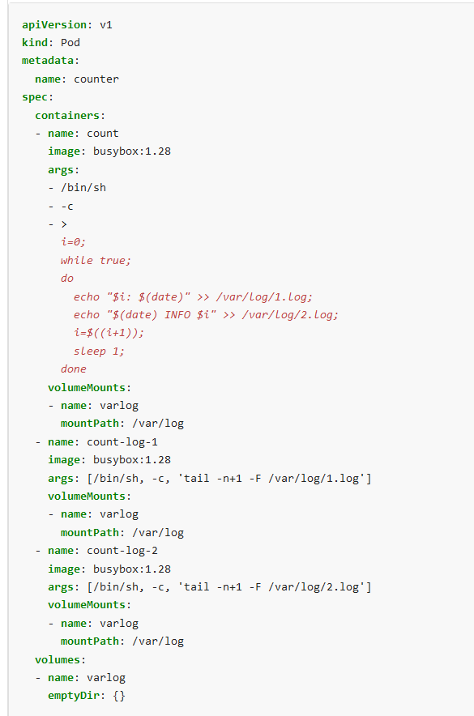
apiVersion: apps/v1 kind: Deployment metadata: creationTimestamp: null labels: app: deployment-007 name: deployment-007 spec: replicas: 1 selector: matchLabels: app: deployment-007 strategy: {} template: metadata: creationTimestamp: null labels: app: deployment-007 spec: containers: - image: busybox:1.28 name: web-one resources: {} args: [/bin/sh, -c, 'while true; do echo "i luv cncf" >> /tmp/log/input.log; sleep 10; done'] volumeMounts: - name: varlog mountPath: /tmp/log - image: busybox:1.28 name: sidecar-two resources: {} args: [/bin/sh, -c, 'tail -n+1 -F /tmp/log/input.log'] volumeMounts: - name: varlog mountPath: /tmp/log volumes: - name: varlog emptyDir: {}

Slide 17
Application Design and Build 20%
Define, build and modify container images
Choose and use the right workload resource (Deployment, DaemonSet, CronJob, etc.)
Understand multi-container Pod design patterns (e.g. sidecar, init and others)
Utilize persistent and ephemeral volumes

Slide 18
Application Design and Build 20%
Define, build and modify container images
Choose and use the right workload resource (Deployment, DaemonSet, CronJob, etc.)
Understand multi-container Pod design patterns (e.g. sidecar, init and others)
Utilize persistent and ephemeral volumes

Slide 19
Q: you need to create a ConfigMap and consume the ConfigMap in a pod using a volume mount. Please complete the following.
- Create a ConfigMAP named my-config containing the key/value pare. Key3/value2.
- Create a pod named nginx-configmap containing a single container using the nginx image and mount the key you just created into the pod under directory /some/path
kubectl create configmap my-config --from-literal=key3=value2
kubectl create -f q4.pod.yaml
kubectl get po
cat > q4.pod.yaml
apiVersion: v1
kind: Pod
metadata:
name: nginx-configmap
spec:
containers:
- name: mypod
image: nginx
volumeMounts:
- name: foo
mountPath: "/some/path"
volumes:
- name: foo
configMap:
name: my-config
Solution: https://kubernetes.io/
click on documentation
search configMap

Slide 20
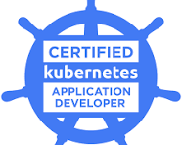
Application Design and Build 20%
Define, build and modify container images
Choose and use the right workload resource (Deployment, DaemonSet, CronJob, etc.)
Understand multi-container Pod design patterns (e.g. sidecar, init and others)
Utilize persistent and ephemeral volumes
Thank you
CKAD Exam Prep

